Slide 1

EXPLORATORY DATA ANALYSIS
Titanic
Dataset Analysis
891 passenger records · 11 features
38.4%
SURVIVED

Slide 2
01 / THE DATA
A compact classification dataset
PassengerId is the index. Survived is the target: 1 = survived, 0 = died. With 38.4% survivors, the classes are moderately imbalanced.
INDEX
PassengerId
TARGET
Survived
TASK
Binary classification
891
11
38.4%
PASSENGERS
FEATURES
SURVIVED

Slide 3
02 / DATA QUALITY
What inspect() revealed
The first pass establishes what can be trusted before any relationship is interpreted.
STRUCTURE
COMPLETENESS
VALIDITY
Shape, column names and data types
Non-null counts expose missing fields
Ranges, categories and suspicious values
Next step: quantify missingness, confirm duplicates, then decide whether to impute, encode or exclude.

Slide 4

03 / STRONGEST FACTOR
Sex sets the baseline
A simple rule — “all women survive, all men die” — predicts 78.7% of outcomes. Any useful model must beat it.
78.7%
BASELINE ACCURACY

Slide 5
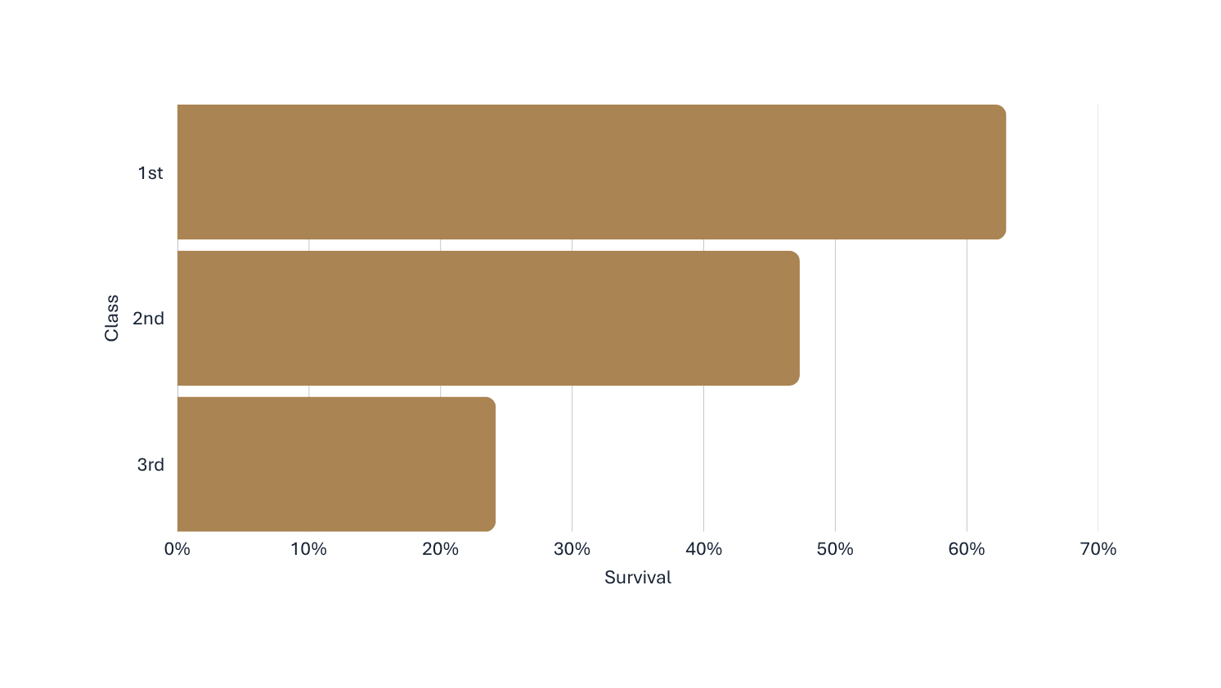
04 / TICKET CLASS
Survival falls with class
55%
TRAVELLED 3RD CLASS

Slide 6
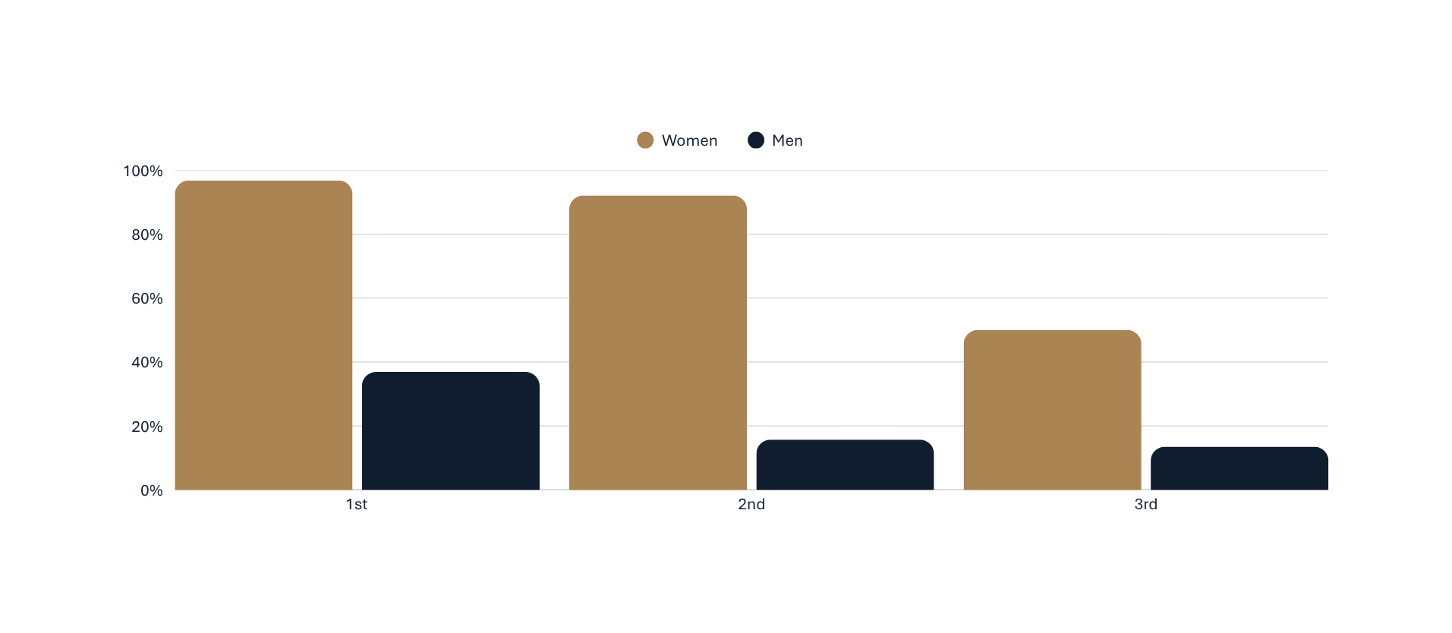
05 / INTERACTION
Sex and class together
For women, class mattered greatly. For men, 1st class more than doubled the odds.

Slide 7
06 / AGE + TITLE
Age matters — title sharpens it
58%
22.7%
CHILDREN 12 AND UNDER
OVER-60s · ONLY 22 PEOPLE
Boys survived at almost
four times the rate
of adult men.
TITLE CAPTURES THE AGE EFFECT

Slide 8
07 / FAMILY SIZE
The relationship is non-linear
Survival peaks in the middle. Treating family size as a straight numeric effect hides the pattern; grouped bands are more useful.
SMALL / MID-SIZE
Peak survival
ALONE
Lower survival
LARGE
Lower survival

Slide 9
08 / CONFOUNDING
Association is not independence
Fare, port and cabin are linked to survival — but they largely duplicate ticket class. Check each relationship within class before claiming a separate effect.
TICKET CLASS
control within class
FARE
PORT
CABIN

Slide 10
09 / NEXT ANALYSES
Move from patterns to robust models
01 MISSING DATA
02 FEATURE ENGINEERING
Compare complete-case analysis with principled imputation.
Build title, family bands and party-level features.
03 VALIDATION
04 INTERACTIONS
Use stratified cross-validation and beat the 78.7% baseline.
Test sex × class and age × title explicitly.

Slide 11
10 / LIMITATIONS
Read the patterns with care
ONE VOYAGE
MISSINGNESS
ASSOCIATION
Historical context is specific; results do not generalize automatically.
Unknown values may be systematic, especially for age and cabin-related fields.
Observed differences are descriptive, not causal estimates.

Slide 12
11 / CONCLUSION
Sex and class
drove survival.
891 × 11
PASSENGERS × FEATURES
“Women and children first” intersected with social position. Age, family size and fare add information, but partly duplicate it.
A strong practice dataset for classification, missing-data handling and feature engineering.

